Slide 1

KIET GROUP OF INSTITUTIONS DEPARTMENT OF COMPUTER APPLICATIONS

Slide 2
CANTEEN MANAGEMENT SYSTEM
MENTOR – Dr. AMIT GUPTA
TEAM MEMBERS – HIMANSHU SHARMA

Slide 3

INTRODUCTION
There will be 2 types of user groups: Customer and Admin.
Admin can also add customer and its details.
We will Develop a UI portal and backend for the same using PHP, MYSQL for connectivity.
Both Customer and Administrator can do different work in this.

Slide 4





TECHNOLOGY USED

Slide 5
FUNCTIONS OF FUNCTIONS OF ADMIN CUSTOMER
Add an customer with its name, email, password, etc.
Update and customer details
Delete an customer details
Login into account from credentials created by admin.
Edit his/her personal details
Place an order

Slide 6
SOFTWARE HARRDWARE REQUIREMENTS REQUIREMENTS
Windows Operating System
Google Chrome
Xamp Server
Desktop / PC

Slide 7
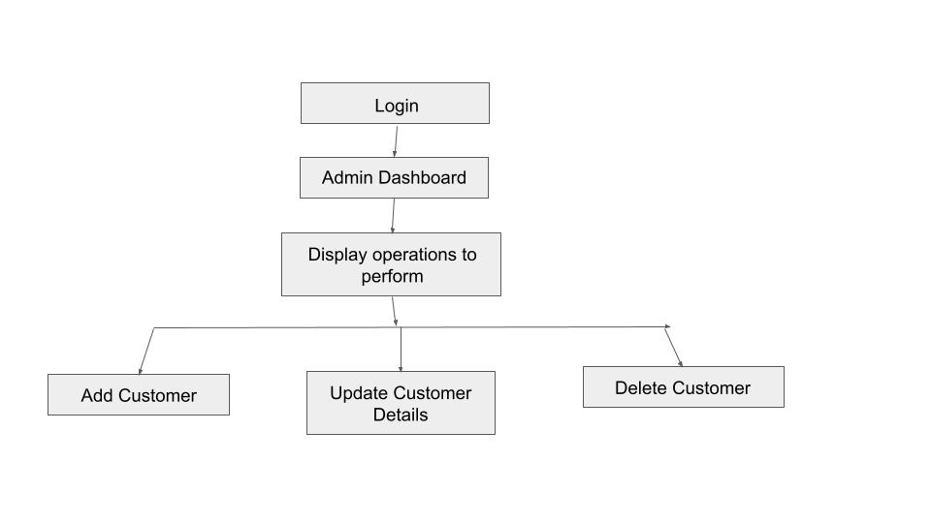
ADMIN OPERATIONS FLOWCHART

Slide 8
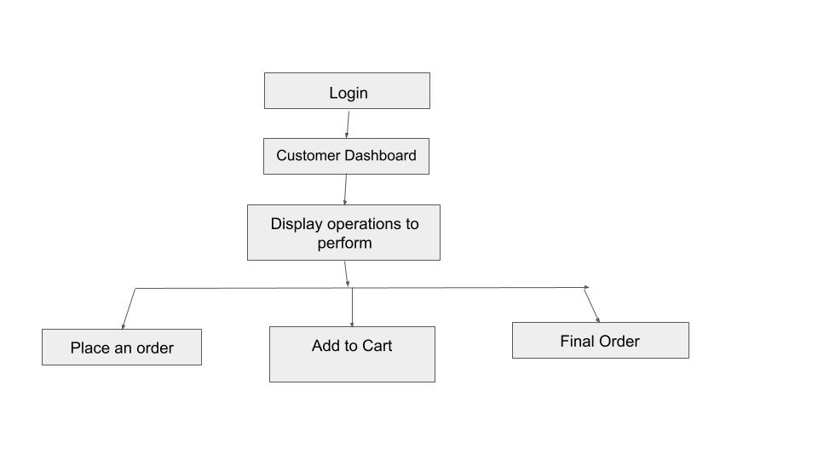
CUSTOMER OPERATIONS FLOWCHART

Slide 9

THANK YOU

